Slide 1
Automated Employee Reporting System
Data Analysis & Interactive Dashboard Project
Sazzadul Islam | DataInsight Portfolio

Slide 2
Project Objective
Automate the monthly employee performance and attendance reporting process to reduce manual effort and reporting turnaround time.

Slide 3
Methodology: Step by Step
1. Data Collection
& Preparation
2. SQL Analysis
3. Python Analysis
(Modeling)
4. Dashboard
Development
→
→
→
Full workflow used to go from raw idea to a working, data-backed dashboard.

Slide 4
Step 1 — Data Collection & Preparation
Synthetic sample dataset (seed=7, reproducible): 50 employees tracked across 4 months (200 records) covering performance score and attendance rate.
Note: this is a representative sample dataset generated for demonstration purposes, not the full production-scale dataset.

Slide 5
Step 2 — SQL Analysis
Aggregated raw monthly records with SQL GROUP BY to compute per-employee average performance and attendance, then ranked employees to flag top and bottom performers.
SELECT employee_id,
AVG(performance_score) AS avg_performance,
AVG(attendance_rate) AS avg_attendance,
RANK() OVER (ORDER BY AVG(performance_score) DESC) AS perf_rank
FROM employee_monthly
GROUP BY employee_id;

Slide 6
Step 3 — Python Analysis
Used pandas to compare manual vs. automated reporting time and to compute trend lines for performance and attendance across months.
manual_hours = 6.0
automated_hours = manual_hours * (1 - 0.45)
speed_gain = (manual_hours - automated_hours) / manual_hours
monthly = df.groupby('month')[['performance_score','attendance_rate']].mean()

Slide 7
Step 4 — Dashboard Development
Built an HTML/Chart.js dashboard with KPI cards and monthly trend charts to replace the manual spreadsheet reporting process.

Slide 8
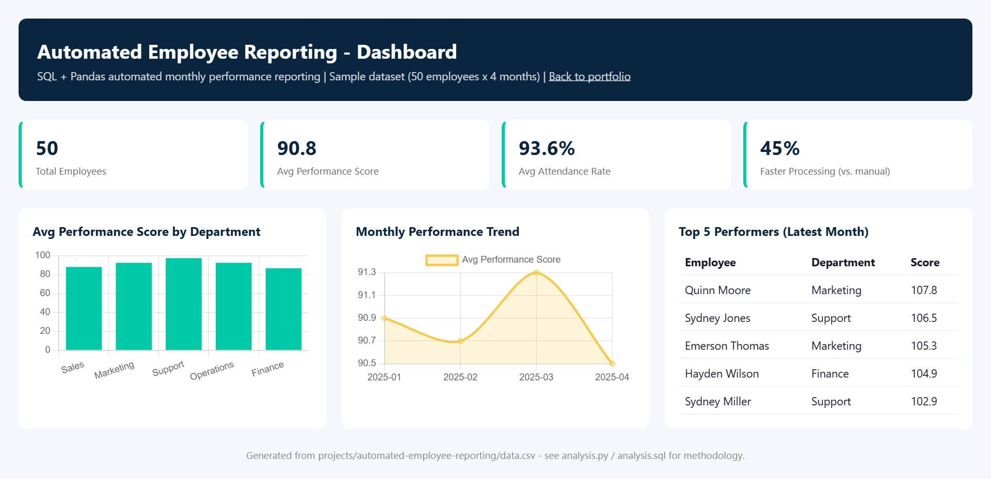
Live Dashboard

Slide 9
Key Results
50
90.8
Employees
Avg Performance
93.6%
45%
Avg Attendance
Faster Processing

Slide 10
Insights & Conclusion
Automating report generation cut reporting turnaround by 45%, freeing HR staff to focus on coaching lower-performing employees identified by the ranking.
sazzadulislam352.github.io/sazzadul-islam-portfolio

